Slide 1


COBOL compilers
Varun Khadayate
A016

Slide 2
About
COBOL (Common Business Oriented Language)
COBOL is one of the oldest programming languages. It's a high-level programming language. The program should be compiled to a low-level machine language code (i.e. object code/load module) so that the program can be executed on a machine.
A COBOL compiler is a software program/tool. It’s used to translate high-level COBOL programs into low-level executable code.
The input to the compiler is high-level COBOL program code and the output would be object code/machine code.
COBOL compiler performs four important functions:
Syntax Scanning.
Semantic Analysis.
Code optimization.
Code Generations.

Slide 3
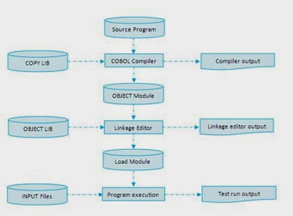
COBOL Program Compilation Process.

Slide 4

Some real time examples
Business
Finance, and administrative systems for companies
Governments
COBOL is still widely used in applications deployed on mainframe computers

Slide 5
Tools on which it executes
Fujitsu Net COBOL
Gnu COBOL
IBM COBOL
Micro Focus

Slide 6
Basic mechanism
Step 1
The COBOL compiler compiles the source program into an object module. If necessary, it gets the copy members it needs for the compilation from the specified copy libraries.
During compilation, the compiler produces output that can be printed or displayed on the terminal or monitor.
Step 2
The linkage editor links the object program with any subprograms it needs, thus creating an executable program called a load module.
On most systems, the linkage editor links the object program with one or more system subprograms. However, it can also link it with COBOL subprograms.
Step 3
The executable program runs so you can see whether it works correctly. This is the testing phase of program development.

